Slide 1
Horseshoe Process Model
P20-0010 Fareeba Sundas Jamshed
P20-0453 Hadeed Bin Tufeeque
P21-8321 Lalain Awan

Slide 2
Table of contents
Overview
Phases
Case study
Benefits
Challenges
Conclusion

Slide 3
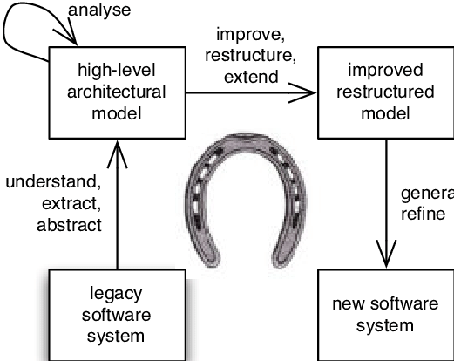
Why its named as horseshoe process model?

Slide 4
Introduction
The Horseshoe Process Model for Reengineering is named after the shape of a horseshoe. The horseshoe shape is often used as a metaphor to represent a cyclical or iterative process. In the context of reengineering, the horseshoe shape may signify the cyclical nature of the process, where there is continuous improvement, iteration, and refinement of the reengineering efforts. It suggests that the reengineering process is not linear but involves multiple iterations and feedback loops to achieve desired outcomes.
The Horseshoe Process Model is a framework used in software reengineering to guide the systematic transformation of existing software systems. It emphasizes iterative and incremental approaches, focusing on evaluation and planning throughout the reengineering process.

Slide 5
Significance in Software Reengineering:
In software reengineering, the Horseshoe Process Model holds significance as it provides a structured approach to address the challenges associated with legacy systems, outdated technologies, and evolving business requirements. By breaking down the reengineering process into distinct phases, it enables organizations to effectively manage complexities and mitigate risks.

Slide 6
Basic Principles:
The basic principles of the Horseshoe Process Model include an iterative and incremental approach, where improvements are made incrementally over time, allowing for continuous evaluation and refinement. The model emphasizes the importance of thorough evaluation and planning to ensure successful reengineering outcomes.

Slide 7
Phases of the Horseshoe Process Model
Evaluation phase
Planning phase
Migration phase
Validation
Maintenance

Slide 8
Case Study: Streamlining Inventory Management in a Retail Store
Background:
A retail store specializing in electronics has been facing challenges with its inventory management system. The existing process involves manual tracking of inventory, which often leads to discrepancies, stockouts, and excess inventory. As a result, customer satisfaction is affected, and the company incurs losses due to inefficient inventory management practices.

Slide 9
Application of Horseshoe Process Model:
Evaluation Phase:
The company begins by assessing its current inventory management process, identifying pain points, and understanding stakeholder needs. Data is collected on current inventory levels, turnover rates, ordering processes, and customer demand patterns.
Planning Phase:
Using insights gathered during the assessment phase, the team envisions an ideal inventory management system. They propose implementing a centralized inventory database with real-time tracking capabilities, automated reorder points, and predictive analytics for demand forecasting. The team also envisions integrating barcode scanning technology for efficient inventory tracking and reducing manual errors.

Slide 10
Application of Horseshoe Process Model:
Design Phase:
In this phase, the team creates a detailed blueprint for the new inventory management system based on the reimagined process. They collaborate with software developers to design a user-friendly interface for the inventory management software. Additionally, they design training programs for staff to ensure smooth transition and adoption of the new system.
Implementation Phase:
The new inventory management system is rolled out in phases to minimize disruption to daily operations. Staff members are trained on how to use the new software and barcode scanning equipment. Feedback loops are established to gather input from users and make necessary adjustments during the implementation process.
Validation Phase:
After the new system has been fully implemented, the team evaluates its effectiveness in improving inventory management. Key performance indicators such as inventory turnover, stockout rates, and customer satisfaction scores are monitored. Any issues or bottlenecks that arise during the evaluation phase are addressed promptly through continuous improvement efforts.

Slide 11
Outcomes:
The implementation of the new inventory management system leads to a significant reduction in stockouts and excess inventory.
Inventory turnover rates improve, resulting in better cash flow and reduced carrying costs.
Customer satisfaction levels increase due to improved product availability and faster order fulfillment.
The company achieves cost savings through greater operational efficiency and reduced manual labor.
By following the Horseshoe Process Model, the retail store successfully reengineers its inventory management process, resulting in tangible improvements in performance and profitability.

Slide 12
Benefits of the Horseshoe Process Model
Increased Flexibility in Adapting to Changing Requirements: The iterative nature of the model allows for flexibility in accommodating changes and evolving requirements.
Better Risk Management Through Iterative Development: By addressing risks incrementally and continuously evaluating progress, the model enables effective risk management.
Improved Alignment with Business Goals and Customer Needs: Through thorough evaluation and planning, the reengineered software is better aligned with business goals and customer needs.

Slide 13
Challenges and Considerations
Need for Thorough Analysis and Planning Before Implementation: Inadequate analysis and planning can lead to project delays, cost overruns, and suboptimal outcomes.
Potential Resistance to Change From Stakeholders: Resistance from stakeholders can pose challenges during the reengineering process and may require effective communication and change management strategies.
Risk of Scope Creep and Budget Overruns if Not Managed Effectively: Without proper controls, the project may experience scope creep, leading to increased costs and delays.

Slide 14
Conclusion
In summary, the Horseshoe Process Model provides a structured approach to software reengineering, emphasizing iterative development, evaluation, and planning. Its significance lies in its ability to manage complexities, mitigate risks, and align reengineering efforts with business goals and customer needs. Through case studies and examples, we have seen how the model can be applied to achieve successful outcomes in real-world scenarios. However, it's important to acknowledge the challenges and considerations involved and address them proactively to ensure the success of reengineering initiatives.

Slide 15
THANKYOU!

